Slide 1
Superstore Sales & Profitability Analysis
Tess Kamau - AnalystLab Africa Data Analytics Internship — Week 4
06/08/2026

Slide 2
Dataset Overview
Superstore Sales Dataset (Kaggle)
US retail orders 2014-2017
9,994 rows / 21 columns / no missing values
Key fields: Sales, Profit, Discount, Category, Region, Order Date

Slide 3
Business Problem
Where is the business truly profitable, and where is it quietly losing money despite strong sales?

Slide 4
KPIs Defined
Total Sales: $2.30M
Total Profit: $286.40K
Total Orders: 5,009
Profit Margin: 12.47%

Slide 5
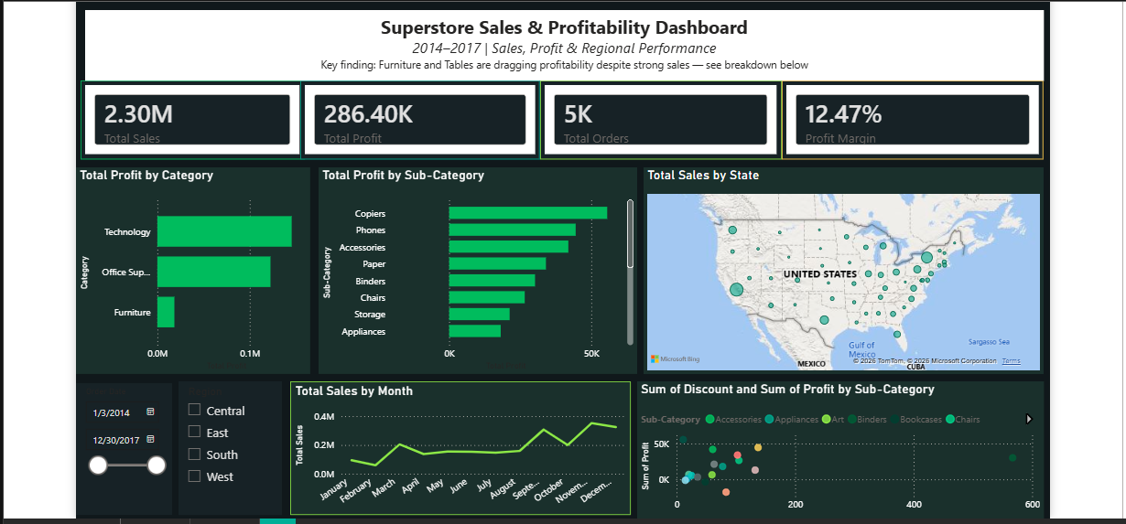
Dashboard Overview

Slide 6
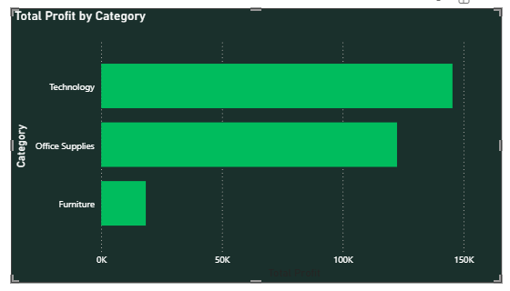
Insight 1: Furniture Underperforms Despite High Sales
Furniture generated $741,999 in sales — nearly identical to Office Supplies ($719,047)
Yet Furniture profit was just $18,451 — compared to $145,455 for Technology and $122,491 for Office Supplies
Furniture's profit margin is far below the other two categories despite similar or higher sales volume

Slide 7
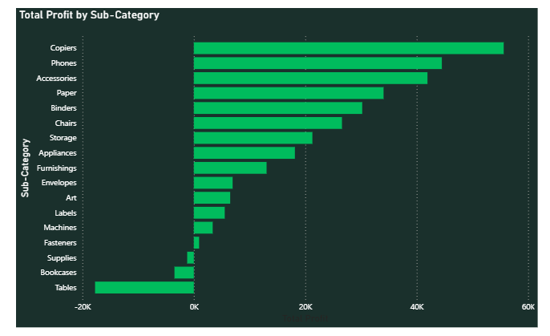
Insight 2: Discounting Is Eroding Profit on Specific Sub-Categories
Tables lost $17,725 despite generating $206,965 in sales — the single worst-performing sub-category
Bookcases also operated at a loss, losing $3,473
However, heavy discounting alone doesn't explain everything: Binders had the highest total discount of any sub-category ($567) yet remained profitable (+$30,222)
This suggests Tables' losses come from a combination of steep discounting AND thin base margins — not discounting alone

Slide 8
Recommendations
1.Cap discounts on Tables and Bookcases — review and reduce discount thresholds on these two sub-categories specifically, since deep discounting is directly linked to their losses
2.Don't assume high discount = low profit everywhere — Binders proves discounting can coexist with profitability; discount policy should be set per sub-category based on actual margin data, not a blanket rule
3.Investigate Furniture's cost structure — since Furniture sells nearly as much as Office Supplies but earns 8x less profit, the issue may be supplier costs, shipping, or pricing — not just discounting — and deserves its own follow-up analysis
4.Double down on West and Technology — both are the strongest performers (West by region, Technology by category) and are good candidates for continued or increased investment
Plan inventory and staffing around the November sales peak — the seasonal trend shows a clear Q4 spike worth preparing for in advance

Slide 9
Conclusions and Key Takeaways
Challenges faced - Power BI's map visual repeatedly disabled itself and needed a full application restart to render correctly
What I learned:
How to translate raw sales data into KPIs that answer real business questions
The importance of testing assumptions with data discounting alone didn't explain Tables' losses, Binders proved that
Building interactive dashboards means designing for someone else to explore, not just presenting static findings
Github Link: github.com/Tee-ai63

